Slide 1
HEART DISEASE PREDICTION USING MACHINE LEARNING
Submitted in the partial fulfillment for the award of the degree of
BACHELOR OF ENGINEERING
IN
DevOps
Submitted by:
Vinay Partap Singh – 22BDO10040
Yash Kumar – 22BDO10009
Vibhanshu Sharawat – 22BDO10017
Under the Supervision of:
Shilpa Sharma (E17638)
Department of AIT-CSE
DISCOVER . LEARN . EMPOWER

Slide 2

Outline of Our Presentation
Introduction
Objective
Dataset
Data Processing
Model Evaluation Metrics
Conclusion
Future Scope
References

Slide 3
Introduction
Leveraging AI for Early Diagnosis and Prevention
Heart Disease: Leading cause of death globally.
Challenge: Early diagnosis is difficult, especially without symptoms.
Solution: Use machine learning (ML) to predict the likelihood of heart disease using patient data.

Slide 4
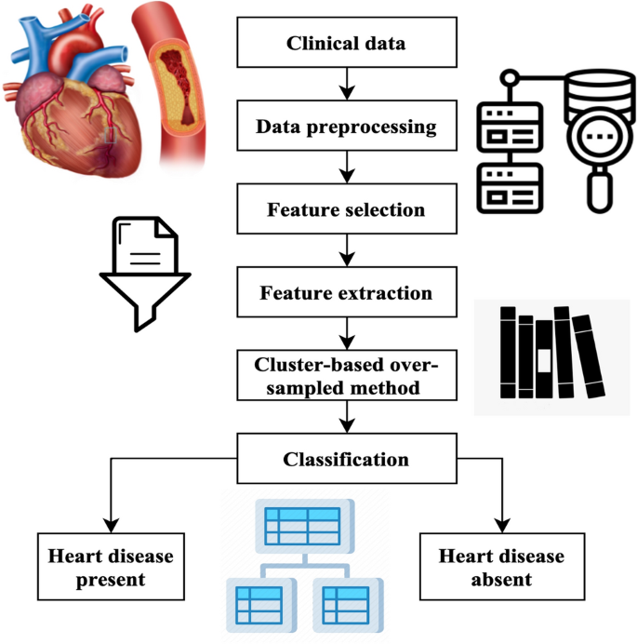
Objective
Build a machine learning model that can predict whether a patient has heart disease based on medical parameters.
Improve diagnostic accuracy and assist healthcare professionals.

Slide 5
DataSet
Source: UCI Heart Disease Dataset
Features:
Age
Sex
Chest Pain Type
Resting Blood Pressure
Cholesterol
Fasting Blood Sugar
Rest ECG
Max Heart Rate
Exercise Induced Angina
ST Depression
Slope of ST Segment
Number of Major Vessels
Thalassemia
Target (0 = No Disease, 1 = Disease)

Slide 6
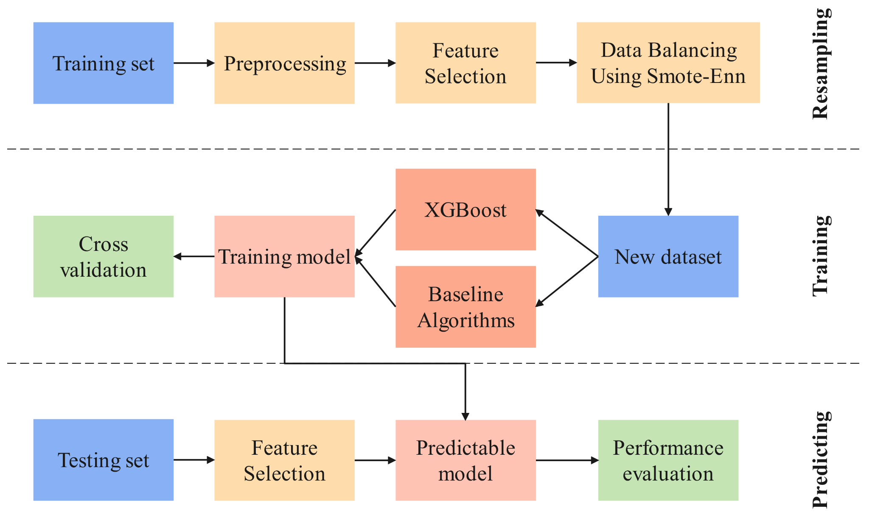
Data Processing
Handling missing values
Encoding categorical variables
Feature scaling
Splitting data into training and testing sets (e.g., 80:20)

Slide 7
Model Evaluation Metrics
Accuracy
Precision
Recall
F1-Score
ROC-AUC Curve
Use of Confusion Matrix to visualize result

Slide 8
Conclusion
ML algorithms can effectively predict heart disease.
Random Forest and Logistic Regression performed best.
Model can assist doctors in early diagnosis.
Needs integration with real-time clinical systems for full impact.

Slide 9

Future Scope
In the future, our research aims to further enhance the reliability of our conclusions by incorporating additional datasets. We will explore the use of metaheuristic techniques and nature-inspired algorithms to optimize the parameters of machine learning classifiers and deep learning methods. This optimization process will enable us to more effectively evaluate the presence of heart disease across various heart disease-related datasets. Additionally, we will focus on improving the accuracy of existing algorithms to enhance their performance in detecting heart disease. By leveraging these advancements, we aim to provide more robust and accurate methods for the diagnosis and evaluation of heart disease.

Slide 10
Thank you
Have a nice day!!

Slide 11
References
ML algorithms can effectively predict heart disease.
Random Forest and Logistic Regression performed best.
Model can assist doctors in early diagnosis.
Needs integration with real-time clinical systems for full impact.

